Slide 1
Linking Modules
Multi-files programming

Slide 2
Why multi-files
Sophisticated programs can be overwhelmingly complex
If it is complex then it is a problem
The classic solution is to use the “Divide and Conquer Principle”
The job of the architect is to break down a rather complex structure into small and manageable components
Defining the interfaces between the components is the key

Slide 3
Functions
Divide a complex functionality into smaller functions
Functions are supported by the processor architectures
CALL and RETURN instructions are available
CALLing a function can involve parameters that make them more versatile and generic
Passing or sharing a parameter between the CALLER and the CALLEE is done using the stack.

Slide 4
Function Design
A function is a sequence of instruction that starts at a certain address
The function is identified by the starting address or entry point
The function is invoked by adding a CALL instruction with the address of the function as an operand.
At the end of the execution of the instructions of the function it should return to the instruction following the CALL

Slide 5
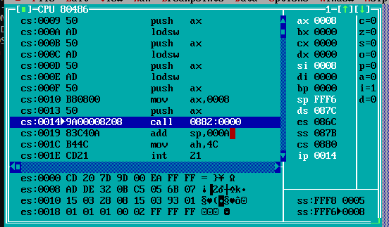
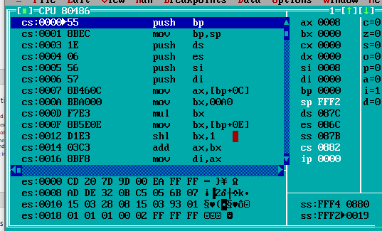
Function implementation
Before calling the function
After calling the function

Slide 6
What happened when calling a function
Obvious changes
The code segment CS and Instruction Pointer IP register changes
The stack pointer SP register is decremented by 4 bytes

Slide 7
What happened during the CALL instruction
Before:
Address: 0080:0014
CS: 0080
IP: 0014
Instruction: 9A00008200
OPCODE : 9A
OPERAND: 00008200
SS: 087B
SP: FFF6
Stack
087B:FFF6: 0008
087B:FFF8: 0005
After:
Address: 0082:0000
CS: 0082
IP: 0000
SS: 087B
SP: FFF2
Stack
087B:FFF2 0019
087B:FFF4 0880

Slide 8
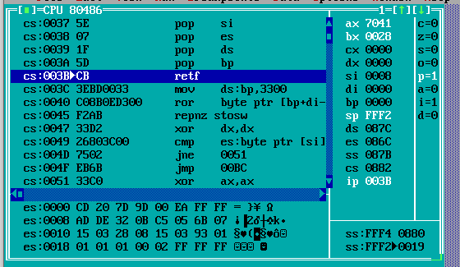
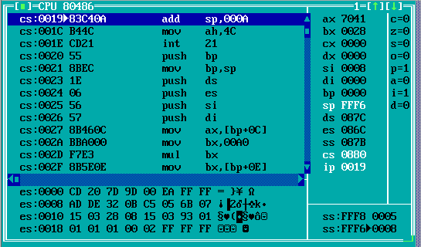

Slide 9
What happened during RETF instruction
Before:
Address: 0082:003B
CS: 0080
IP: 003B
Instruction: CB
OPCODE : CB
OPERAND: None
SS: 087B
SP: FFF2
Stack
087B:FFF2: 0019
087B:FFF4: 0880
After:
Address: 0080:0019
CS: 0080
IP: 0019
SS: 087B
SP: FFF6
Stack
087B:FFF6 0005
087B:FFF8 0008

Slide 10
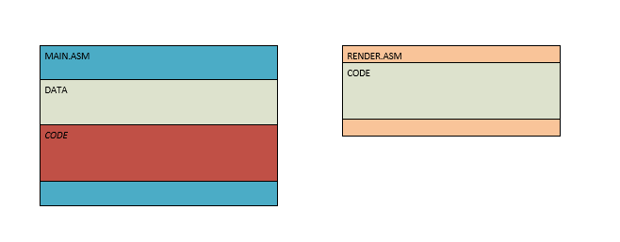
Multiple files

Slide 11
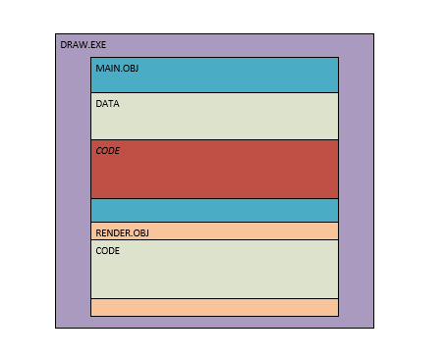
After linking

Slide 12
Function Interface
void Render(int x, int y, int width, int height, char* str) ;
Describes the
Name – The alias to the address of the function
Parameters – The value being shared by the caller to the function
Return value – The value returned by the function to the caller

